Slide 1
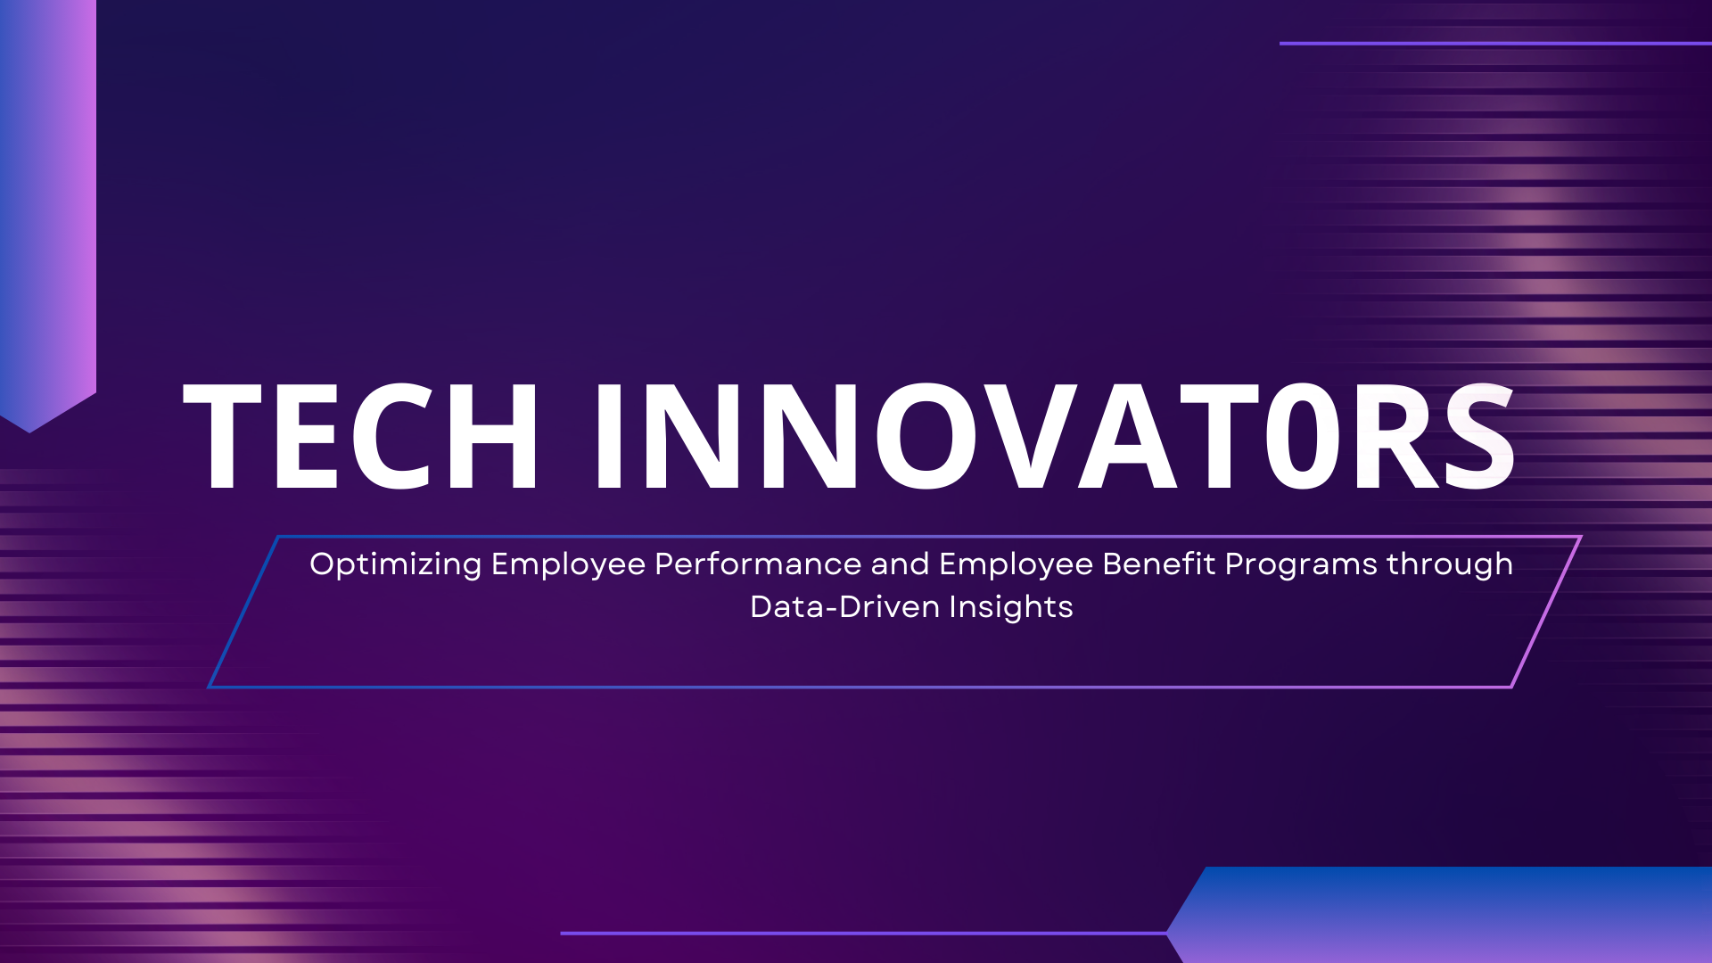

Slide 2
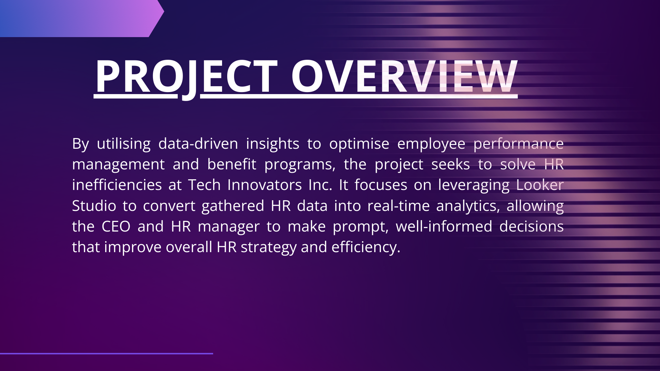

Slide 3
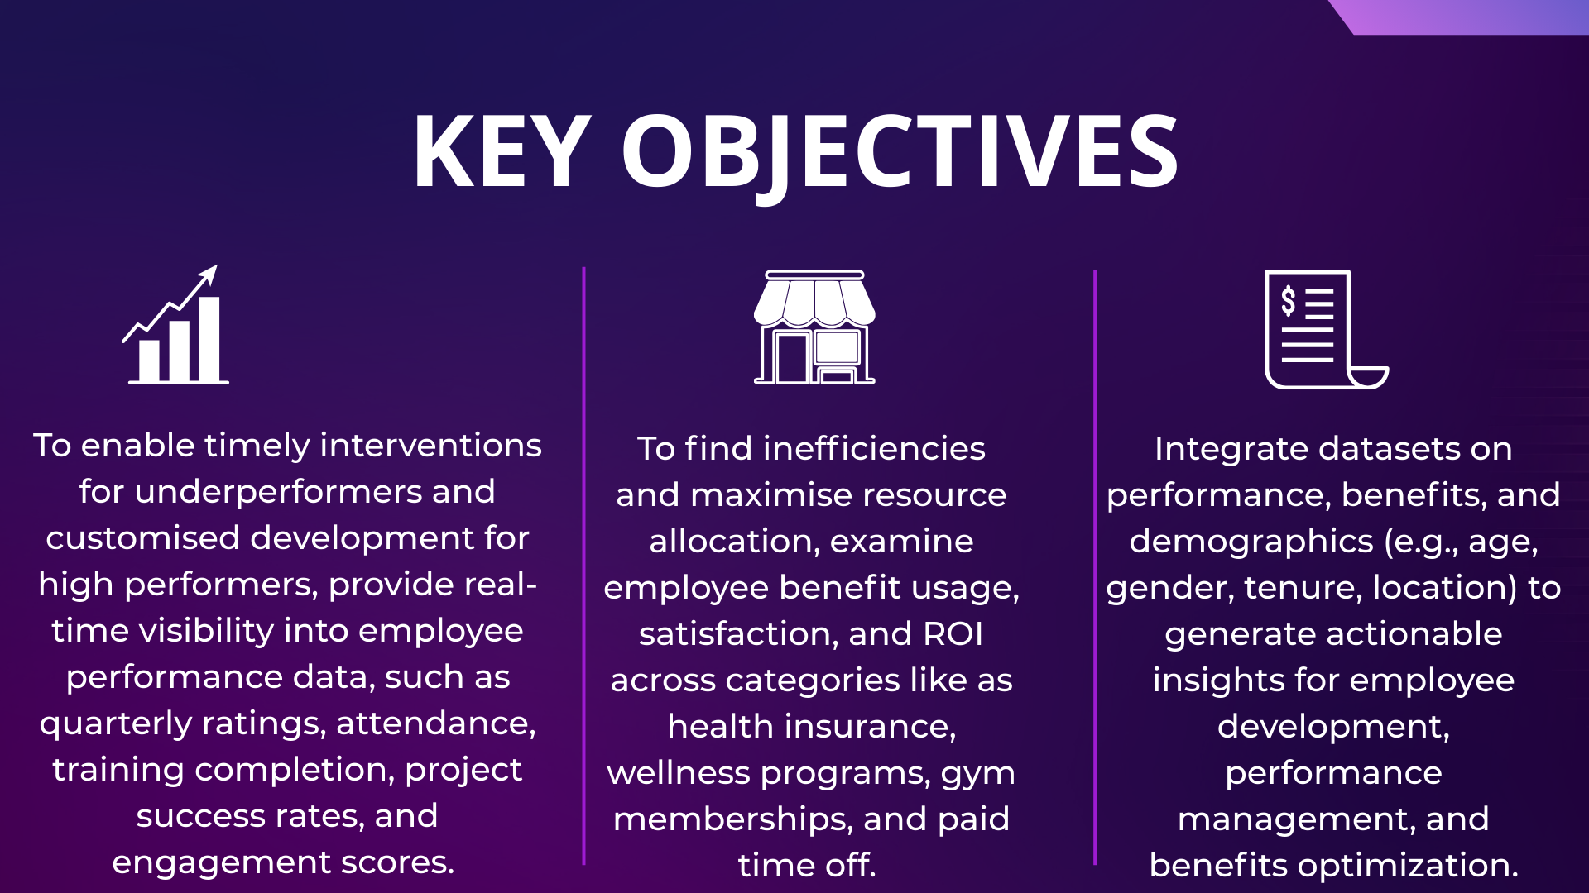

Slide 4
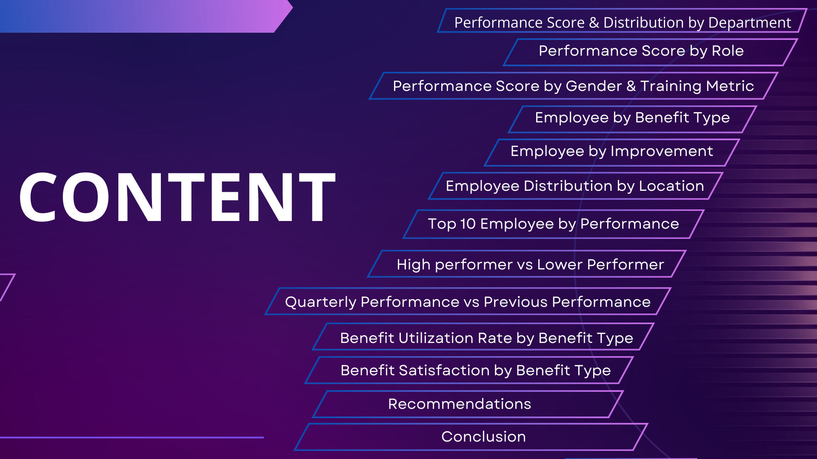

Slide 5

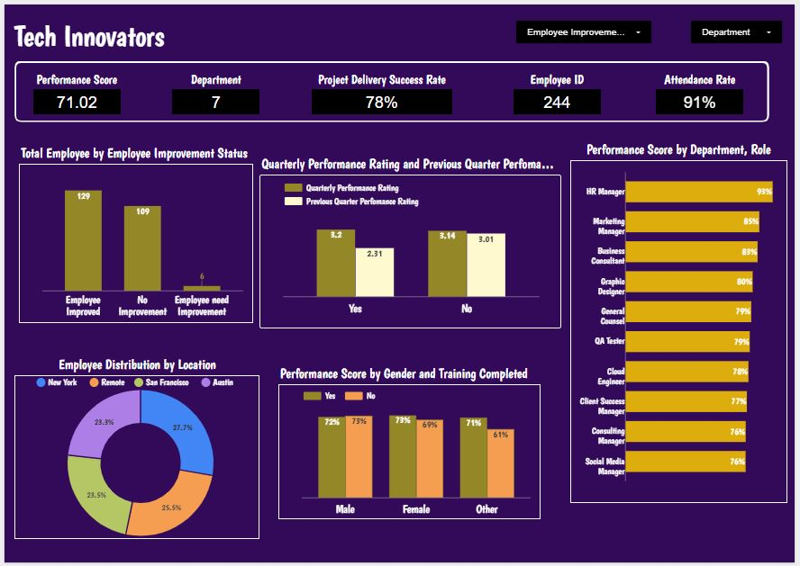

Slide 6
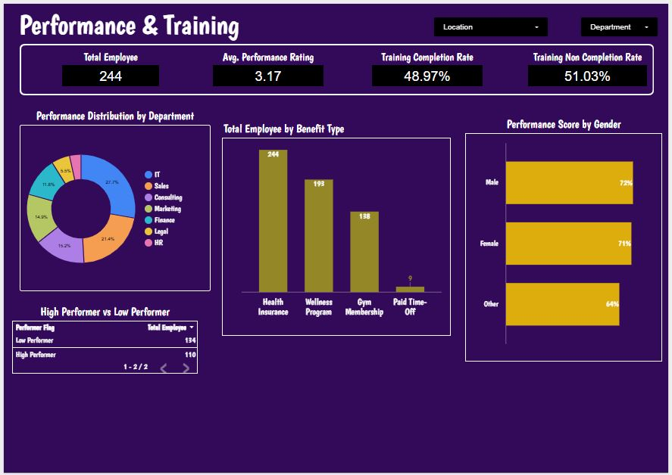

Slide 7
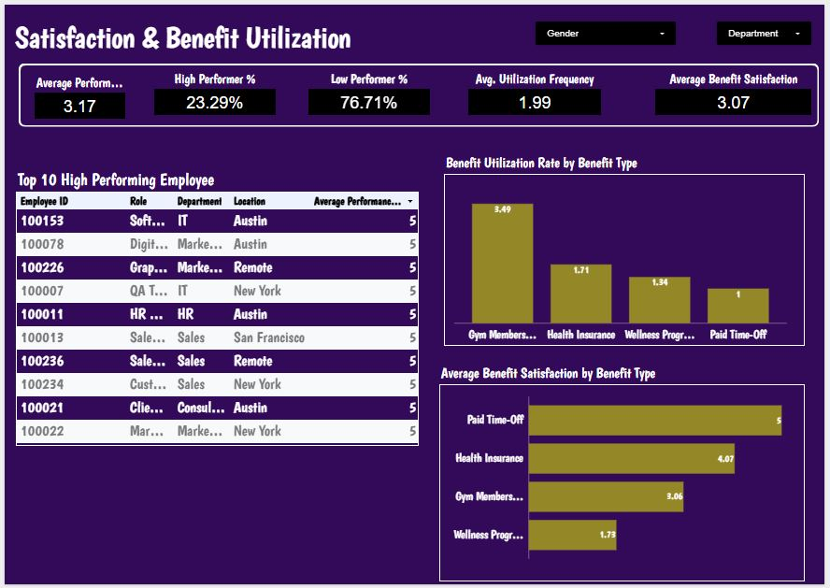

Slide 8
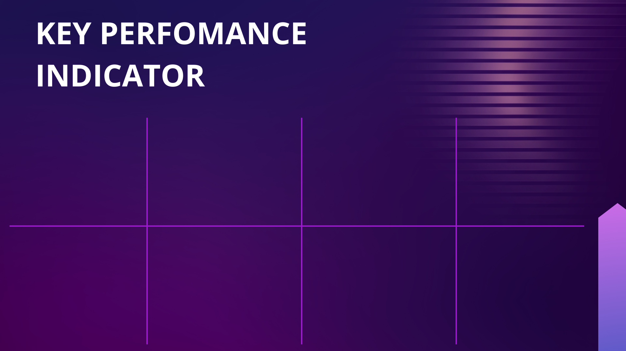
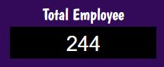
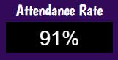
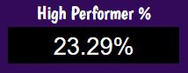
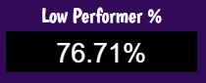
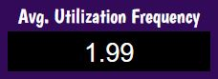
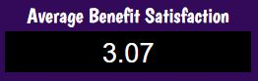
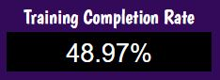
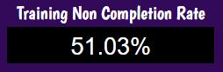

Slide 9
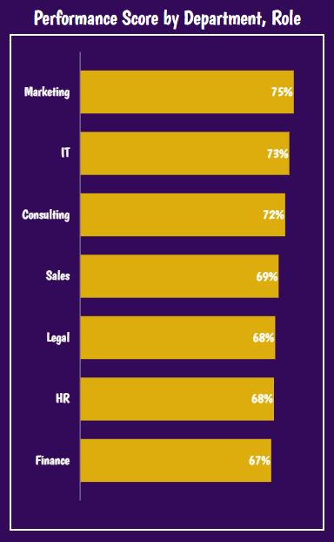
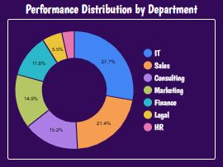
PERFORMANCE SCORE AND DISTRIBUTION BY DEPARTMENT
The Performance Score is High in the Marketing(75%) and IT Department(73%) and Low in the HR(68%), Legal(68%) and Finance(67%) Department
The Performance Distribution is Low in both HR, Legal and Finance department.

Slide 10
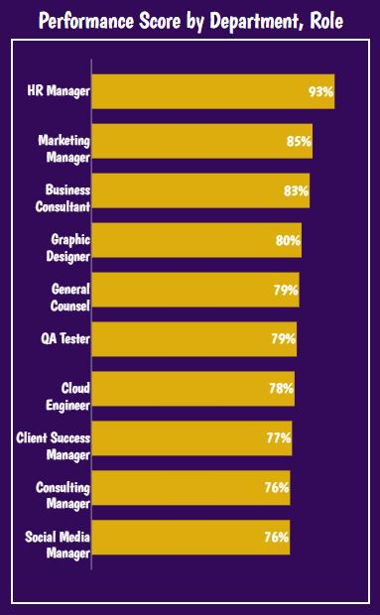
PERFORMANCE SCORE BY ROLE
The HR Manager performance score is 93% while the Social media Manager performance score is 76%

Slide 11
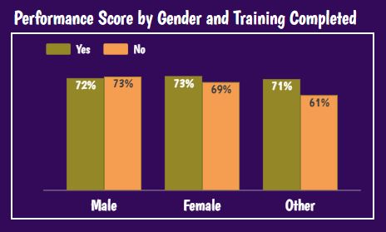
PERFORMANCE SCORE BY GENDER AND TRAINING COMPLETION RATE
The performance score for male with incomplete training is higher than those who completed the Training, while the performance score for the Female and other category for those who completed the training is higher than those with incomplete training

Slide 12
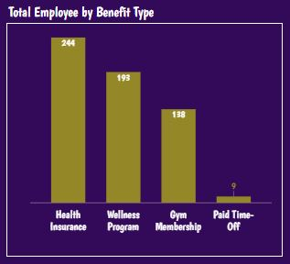
EMPLOYEE BY BENEFIT TYPE
A Total of 244 Employee subscribed to the Health Insurance Befit Type while only 9 Employee had the paid time-off Benefit type

Slide 13
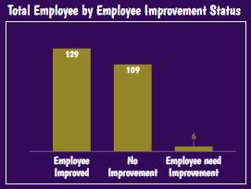
EMPLOYEE BY IMPROVEMENT STATUS
A total of 129 Employee Improved from previous status while 109 Employee has not improved and 6 Employee e needs improvement

Slide 14
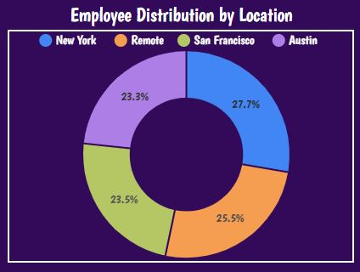
EMPLOYEE DISTRIBUTION BY LOCATION
Employee distribution shows that the largest percentage (27.7%) of Employee work in New York while the least percentage(23.3%) of people work in Austin

Slide 15
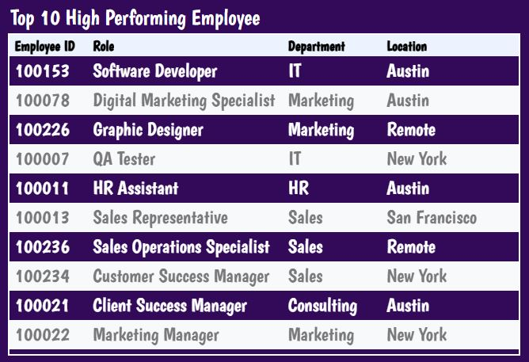

Slide 16
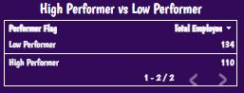
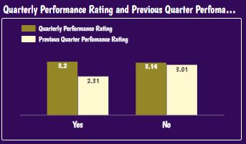
PERFORMANCE RATING
134 Employee are performing lower than requirement while 110 Employee are performing up to expectation.
The performance rating increased significantly for employee who completed the training compared to the performance rating of employees who did not complete the training

Slide 17
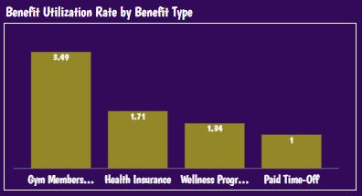
BENEFIT UTILISATION BY BENEFIT TYPE
More Employee utilises the Gym Membership benefit type while paid time-off Benefit type utilisation by employee is very low

Slide 18
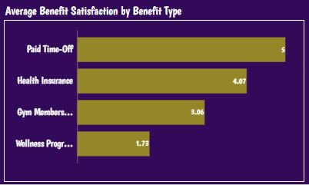
BENEFIT SATISFACTION BY BENEFIT TYPE
The paid Time-off benefit type has been utilised by just few employee and satisfaction level is Excellent while the Wellness Program benefit type has a low satisfaction rate with reference to the total number of employee utilising the benefit type

Slide 19
KEY OBSERVATIONS 1
Marketing (75%) and IT (73%) are top-performing departments
HR, Legal, and Finance are lowest performers (67–68%)
134 employees are underperforming, while 110 meet expectations
Performance ratings improve significantly after training
Highest role score: HR Manager (93%)
Lowest role score: Social Media Manager (76%)

Slide 20
RECOMMENDATIONS
Deploy Department-Level Performance Interventions
Prioritize HR, Legal, and Finance for coaching and workload review.
Assign best-practice mentors from Marketing and IT.
3. Create an Early-Warning Performance System
Implement BI alerts for:
Quarterly rating drops attendance issues.
Missed training completion.
Project under-delivery.
Real-Time Visibility into Employee Performance
Personalized Development for
high & Low Performers
High performers (110 employees): leadership tracks, retention incentives.
Low performers (134 employees): targeted retraining with manager review cycle.

Slide 21
KEY OBSERVATIONS 2
Benefit | Usage | Satisfaction
Gym Membership | Highest (3.49) | Moderate (3.06)
Health Insurance | High | High (4.07)
Wellness Program | Medium | Lowest (1.73)
Paid Time-Off | Lowest usage (9 employees) | Highest satisfaction (~5)

Slide 22
RECOMMENDATIONS
1. Reallocate Benefit Investments
Increase promotion & accessibility of Paid Time-Off (high satisfaction, low usage).
Redesign Wellness Program — low satisfaction despite moderate usage.
Maintain Health Insurance investment — strong ROI.
Optimize Gym program costs — high usage but average satisfaction.
Launch Benefit Awareness Campaign
Many employees are not utilizing high-value benefits → leads to silent attrition risk.
Optimize Employee Benefit Usage, Satisfaction & ROI

Slide 23
KEY OBSERVATIONS 3
Training completion strongly linked to higher performance ratings
Gender + training patterns:
Female & Other → training improves performance
Males with incomplete training currently outperform → risk of plateau
Location insights:
New York hosts highest workforce (27.7%)
Austin lowest (23.3%) but produces multiple top performers

Slide 24
RECOMMENDATIONS
1. Mandatory Training Governance
Enforce 100% training completion policy.
Link performance reviews directly to training status.
Demographic-Driven Talent Management
Use BI models to continuously monitor:
Performance vs training vs gender.
Performance vs location.
Benefits usage vs performance & tenure.
Integrated Workforce Optimization Using Demographics
2. Location-Based Workforce Strategy
Invest in Austin expansion — produces high performers with smaller base.
Optimize staffing in New York — largest workforce, but mixed performance.

Slide 25
CONCLUSION
Strengthening real-time performance monitoring enables early intervention for underperformers and targeted development for high performers.
Targeted training and development programs will drive measurable improvements in productivity and employee effectiveness.
Optimizing benefit investments ensures higher employee engagement while improving return on benefits spending.
Integrating performance, benefits, and demographic data enables proactive, data-driven workforce decisions.
This unified strategy will improve retention, productivity, and organizational resilience, supporting long-term business growth.

Slide 26
THANK YOU

